Slide 1
Project 2: analysis plan
Eduardo Romo
March 30, 2026
Notes:
Hi everyone, today I’ll be presenting my analysis plan and power calculations for Project 2. This project focuses on understanding how inflammation relates to Alzheimer’s disease progression, specifically through changes in cognition and brain structure over one year.

Slide 2
Research Question Overview
Goal: Understand how inflammation relates to AD progression
Aim 1: Evaluate whether peripheral inflammatory markers are associated with one-year change in episodic memory and AD-signature cortical thickness. Hypotheses:
A: higher baseline levels of circulating cytokines and chemokines are associated with declines in memory and cortical thickness
B: increases in these markers over time are associated with greater declines in these outcomes
Aim 2: evaluate whether peripheral inflammation modifies the association between amyloid burden and one-year change in cognition and cortical thickness. Hypothesis
High inflammation + high amyloid leads to greatest decline in cognition and cortical thickness
Notes:
The overall goal of this study is to understand how peripheral inflammation is related to Alzheimer’s disease progression.
In Aim 1, we’re looking at whether inflammatory markers are associated with one-year changes in two key outcomes: episodic memory and cortical thickness. There are two hypotheses here: first, that higher baseline inflammation is associated with greater decline, and second, that increases in inflammation over time are also associated with greater decline.
In Aim 2, we move beyond association and ask whether inflammation modifies the relationship between amyloid burden and these same outcomes. The hypothesis is that individuals with both high inflammation and high amyloid will experience the greatest decline.
So overall, Aim 1 is about main effects, and Aim 2 is about interaction or effect modification.

Slide 3
Data Overview
Outcomes (change from baseline to year 1)
Episodic memory (CVLT, MST, Benson figure, Story recall)
Cortical thickness (AD-signature regions)
Predictors: IL-6, TNF-alpha, MCP-1, Eotaxin-1
Key variables (Aim 2): Amyloid deposition (dichotomized for power)
Adjustment variables:
Age, sex, baseline outcome
Additional covariates (data driven + sensitivity analyses)
Notes:
For the data, all outcomes are defined as change from baseline to one year.
We have episodic memory outcomes, including measures like CVLT and the Mnemonic Similarity Task, and we also have cortical thickness in AD-signature brain regions.
The main predictors are four inflammatory markers: IL-6, TNF-alpha, MCP-1, and Eotaxin-1.
For Aim 2, we also include amyloid deposition, which is dichotomized for the power analysis.
All models will adjust for age, sex, and baseline outcome values. We’ll also consider additional covariates based on their associations with predictors and outcomes, and assess their impact in sensitivity analyses.

Slide 4
Aim 1 Analysis Plan
Linear regression model
Two approaches depending on collinearity:
Joint model (all markers)
Separate models (if collinearity high)
Covariate adjustment:
Age, sex, baseline outcome (always)
Additional covariates (if relevant)
Primary tests:
Joint model ⟶ overall F-test
Separate models ⟶ t-test for marker
Notes:
For Aim 1, we will use linear regression models.
There are two possible modeling approaches depending on collinearity among the inflammatory markers. If collinearity is acceptable, we include all four markers in a joint model. If not, we fit separate models for each marker.
All models adjust for age, sex, and baseline outcome, with additional covariates included as needed.
The primary hypothesis test depends on the model structure:
In the joint model, we use an overall F-test to assess the combined effect of the markers.
In separate models, we use t-tests for each marker coefficient.
So the key decision here is whether we can model all markers together or need to analyze them individually.

Slide 5
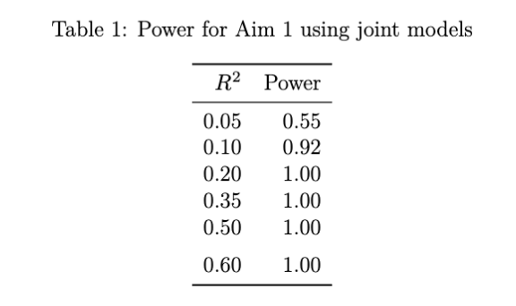
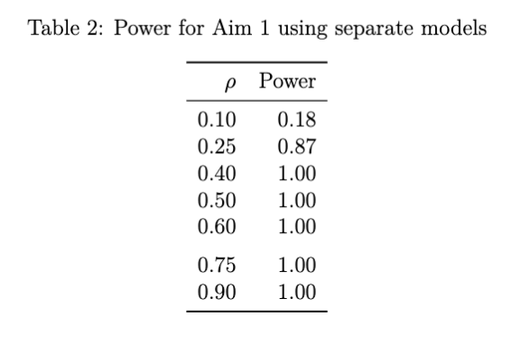
Aim 1: Power Analysis
Power estimated using:
Powertools::mlrF.overall() (joint models)
Powertools::corr.1samp() (separate models)
Based on preliminary data: R² ≈ 0.11 – 0.48
High power (>90%) for modest effects (R² ≥ 0.10)
Separate Models:
Low power for small effects (r = 0.10)
Good power for moderate effects (r ≥ 0.25)
Notes:
For Aim 1, power was evaluated using the powertools package.
For joint models, we used the function mlrF.overall, which corresponds to the overall F-test. For separate models, we used corr.1samp, which corresponds to testing a nonzero correlation.
These calculations were based on preliminary data, which suggested R-squared values between about 0.11 and 0.48.
From the results, we see that power is very high for modest effect sizes — over 90% even at R-squared of 0.10, and essentially 100% for larger effects.
For separate models, power is low for small effects — for example, only about 18% when the correlation is 0.10 — but increases quickly, reaching about 87% at correlation 0.25.
So overall, the study is well powered to detect moderate to large associations, but may miss small effects.

Slide 6
Aim 2: Analysis Plan
Linear regression model with interaction
Primary test: interaction terms
Covariates: Age, sex, baseline outcome
Optional: joint interaction models if low collinearity
Notes:
For Aim 2, we again use linear regression, but now include an interaction term.
Each model includes the inflammatory marker, amyloid deposition, and their interaction, along with baseline outcome, age, and sex.
The primary test here is the interaction term — this tells us whether the effect of inflammation differs depending on amyloid status.
If collinearity is low, we may also fit models including all markers and their interactions, and use a joint test for those interaction effects.
So compared to Aim 1, the key difference is that we’re now testing effect modification rather than just association.

Slide 7
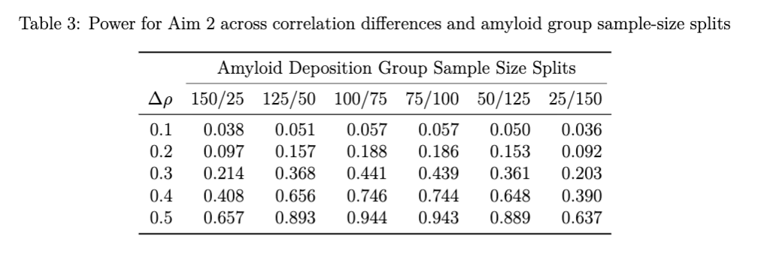
Aim 2 Power & Type 1 Error
Used powertools::corr.2samp
Power results:
Low power for small effects (Δρ = 0.01)
Good power for moderate/large effects (Δρ ≥ 0.3-0.4)
More balanced groups ⟶ higher power
Type 1 Error (for both Aims)
Controlled FWER at 0.05
Two outcome domains: memory and cortical thickness
Bonferroni: ⍺ = 0.025 per domain
Notes:
For Aim 2, power was estimated using corr.2samp, which tests for differences in correlation between two groups — in this case, low versus high amyloid.
This serves as an approximation to the interaction test, since we don’t have preliminary data on amyloid.
From the results, power is very low for small differences in correlation — around 6 to 10 percent when the difference is 0.1.
For moderate differences, power is still somewhat limited, but increases substantially for larger effects. For example, when the difference is 0.4, power exceeds 50% in balanced groups, and for differences of 0.5, it exceeds 90% in most scenarios.
We also see that more balanced group sizes lead to higher power.
So overall, the study is well powered to detect moderate to large interaction effects, but not small ones.
Finally, to control Type I error across multiple outcomes, we used a Bonferroni approach. We defined two outcome domains — memory and cortical thickness — and set alpha to 0.025 for each domain, while interpreting results within each domain collectively.

